Slide 1
6-15 JANUARY 2025

Slide 2
What is AJ2025?

Slide 4
What is a Jamboree?
A large gathering of Scouts. Jamborees are held all over the world.
The Australian Jamboree has been held every three years (now four years) since the first one in 1934. It is attended by Scouts, Venturers, Rovers and Leaders from every state and territory of Australia, as well as many countries from across the globe.
AJ2025 will be the 26th Australian Jamboree. It’s essentially a gigantic scout camp attended by more than 10,000 participants.
Normally an event for the Scout section, it is now open to Venturer Scouts to attend as participants. Thousands of adults attend as Scout Leaders within units or Service Leaders that help run the Jamboree.
Every Jamboree is hosted by a different scouting branch and held in the host’s state.

Slide 5
When and where is the Jamboree?
AJ2025 will be held in Maryborough, Queensland on the Fraser Coast Region. Maryborough is three hours driving time from Brisbane.
The camp site will be located at the the Maryborough Showgrounds and Equestrian Park. AJ2013 was held in the same location, as well as multiple Queensland Cuborees.
Maryborough has a population of approx. 22,000, and is famous for being the birth place of P. L. Travers, the author of Mary Poppins.
The Jamboree will be held from 6-15 January 2025 (10 days).

Slide 6
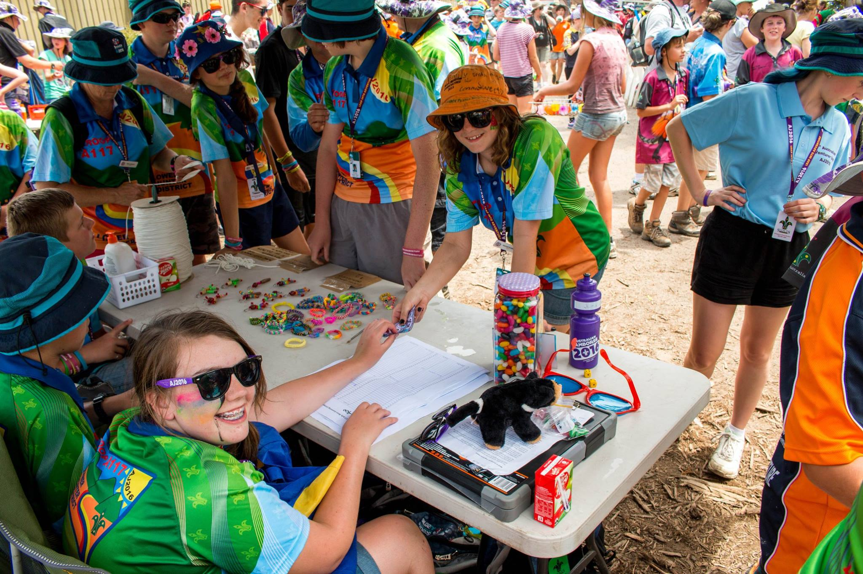
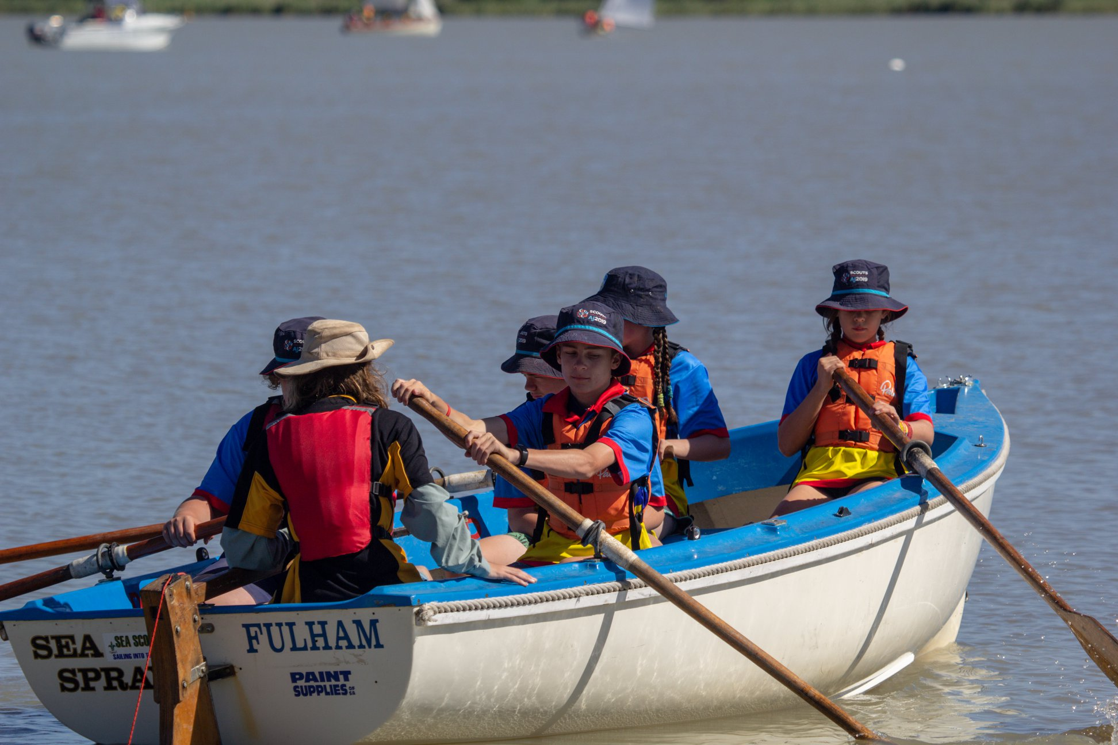
Why go to a Jamboree?
To encourage the physical, intellectual, social, emotional, and spiritual development of young people.
To increase resilience in young people
A chance to make new friends from right across Australia, and the world
Participate in exciting activities, which include off-site activities in the surrounding areas of the campsite. Nightly Entertainment which often features high profile Australian artists,
It will be one the most memorable and impactful experiences you have in Scouts

Slide 7
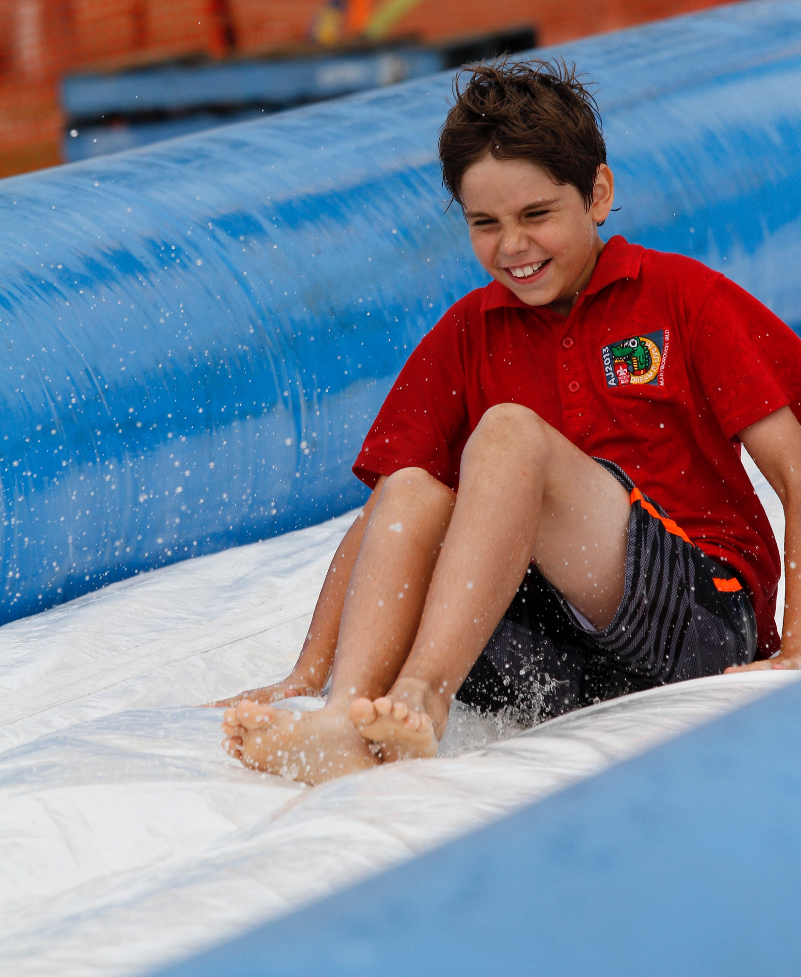
What do you do at a Jamboree?
Program details for AJ2025 to be confirmed shortly. Based on previous Jamborees:
On-Site Activities (Woodwork, Abseiling, BMX Biking, Water Slide, Arts, Laser Tag, many more)
Off-Site Activities (Water Activities, Theme Parks, City Excursions)
Visiting The Mall (Contingent HQ’s, Mini Arena, Shops)
Entertainment (Arena shows, AJ’s Got Talent, Discos)

Slide 8
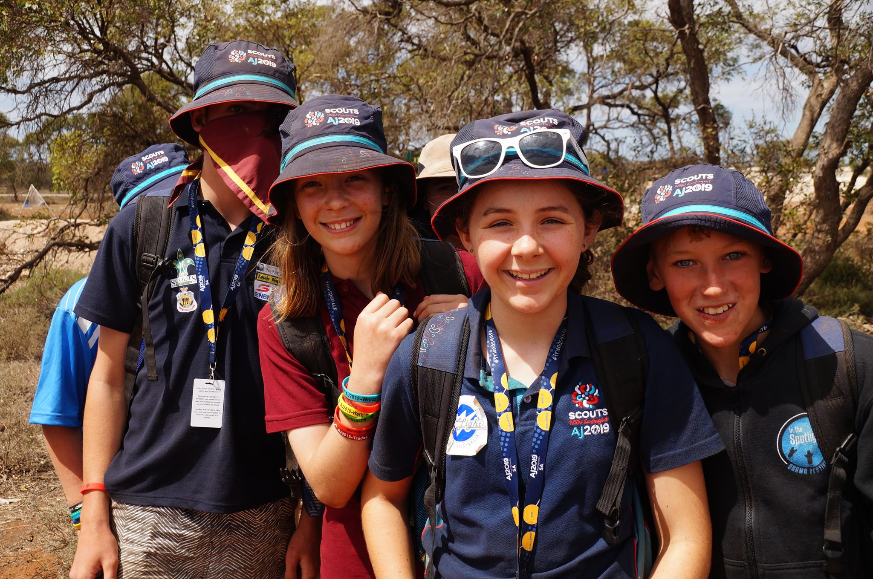
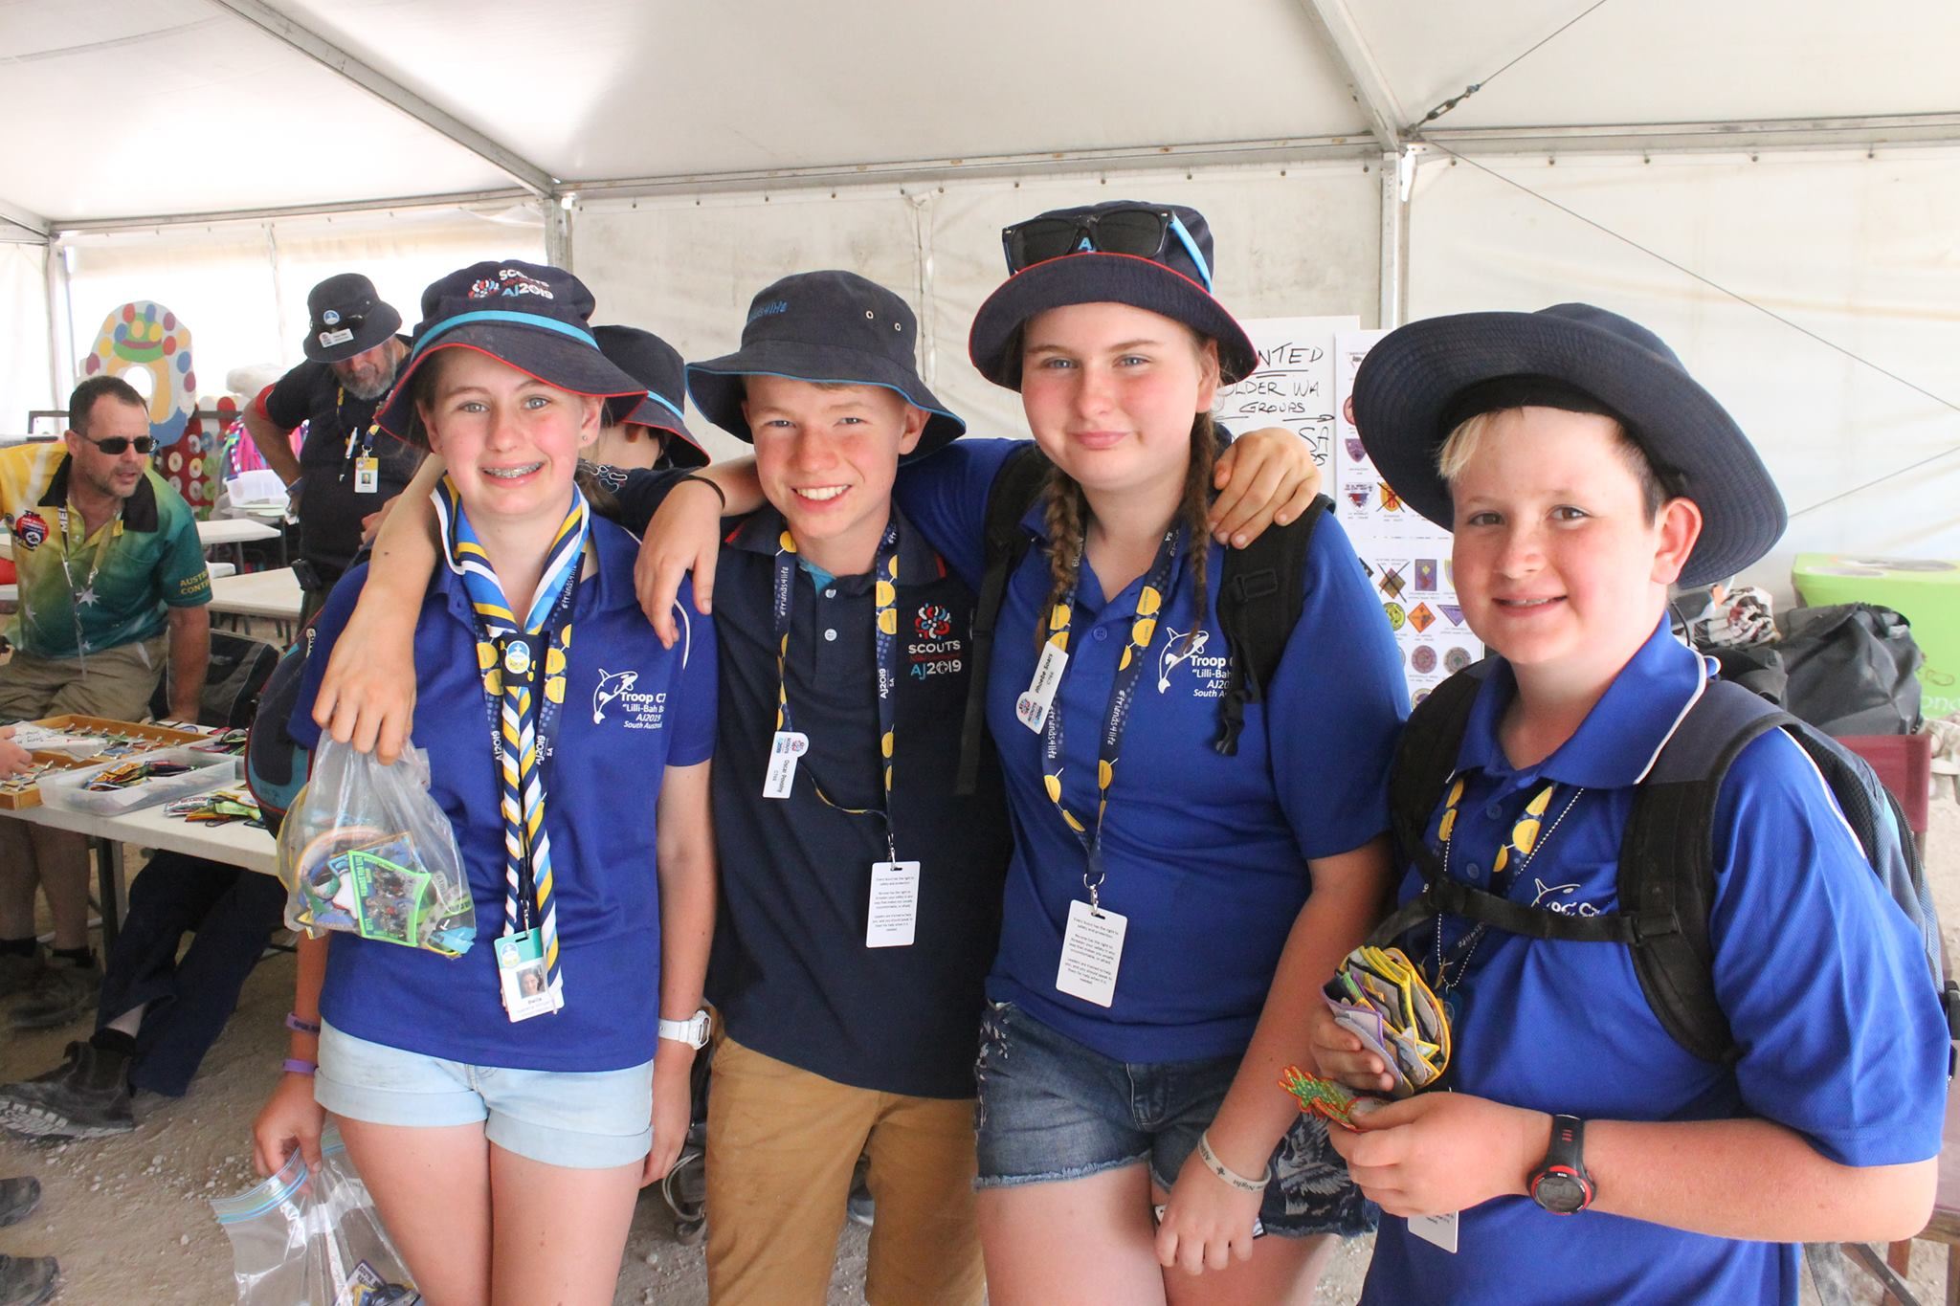
How does a Jamboree work?
The Jamboree will be made up of more than 200 units, each with their own campsite.
Each unit is made up of 36 Scouts/Venturers (making 6 x Patrols of 6), and 4 Line Leaders
Each Adult Leader plays a different role in the unit. A Jamboree Scout Leader, who is responsible for the unit. Normally has experience in attending a Jamboree. The other three leaders focus on the areas of Equipment & Gear (Quartermaster), Activities and Welfare.
Units are normally made of Scouts/Venturers and Leaders from approximately three scout groups from your state/branch, not always from your district/region.

Slide 9
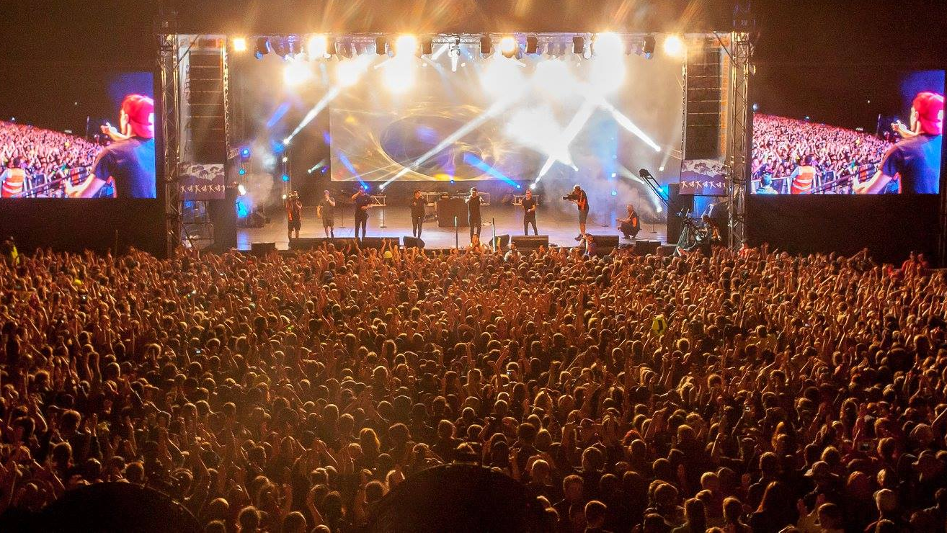
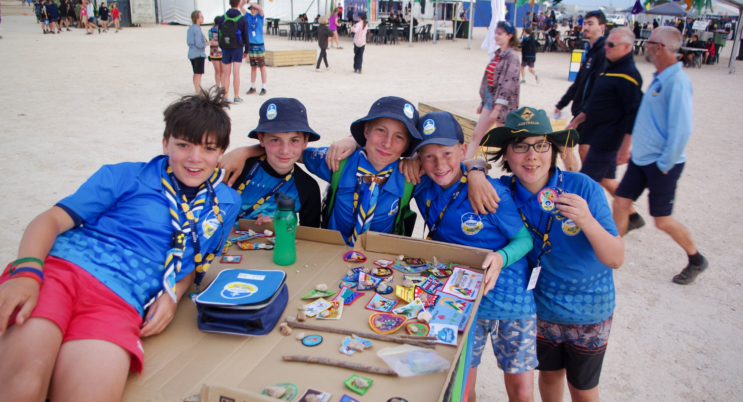
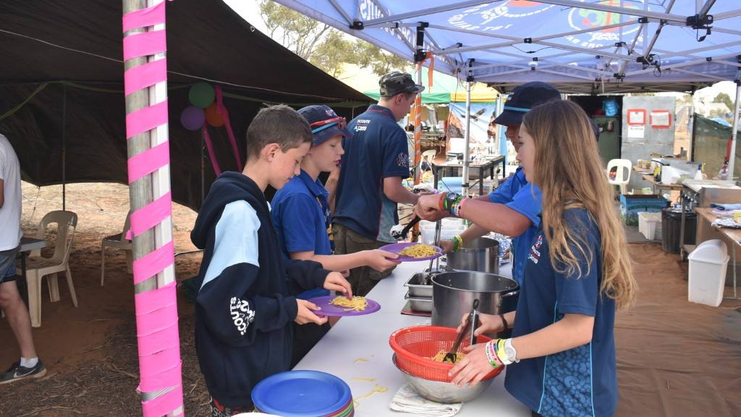
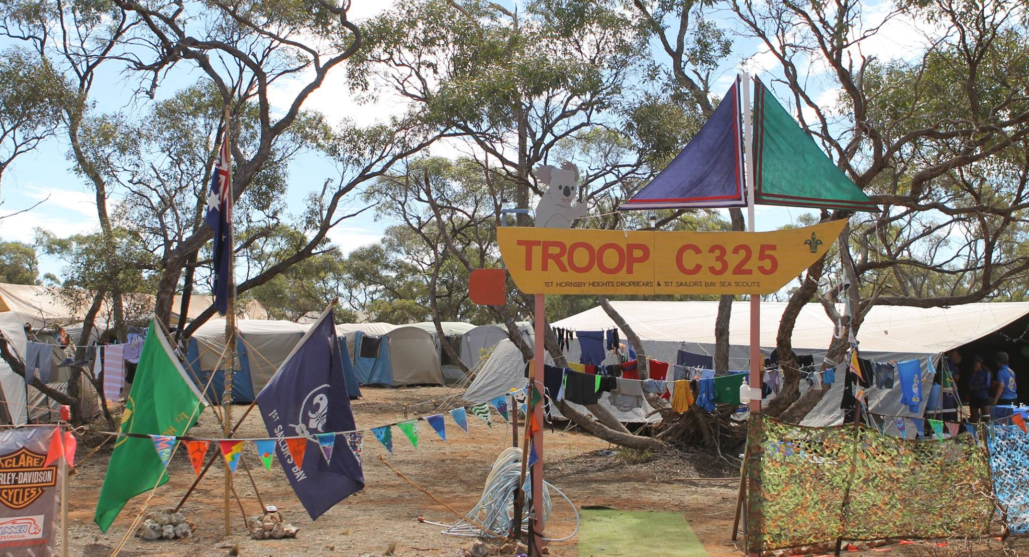
ENTERTAINMENT
BADGE SWAPPING
CAMP LIFE
GATEWAYS

Slide 10
What is a Contingent?
The Contingents are the state-wide/national groups which you belong to and attend the Jamboree on behalf of (example: VIC, SA, TAS, New Zealand, etc)
Contingents are responsible for all the youth members and leaders from their home state whilst they are at the Jamboree
Overseas Scouts and Leaders will also be part of a contingent for their home country
The cost of attending the Jamboree is dependent on your Contingent, based mainly around the transport to the Jamboree that they have chosen
Each Contingent will issue merchandise for their members which may include a polo shirt, luggage bag, backpack, lunchbox, etc (check with your Contingent)
The CMT (Contingent Management Team) are a group of adults who manage and run all aspects of each Contingent. They are your main point of contact for the Jamboree

Slide 11
How do you qualify to attend the Jamboree?
SCOUTS
Must be a current registered Scout Section Member at the time of the event and through until at least 15 January 2025.
Must not have had their 15th birthday as of 6 January 2025
Must have met the requirements, before 1st December 2024 Program Essentials Milestone 1, as well as Outdoor Adventure Skills Stage 3 in Bushcraft, Bushwalking, and Camping
Must have completed 10 nights camping under canvas with the Unit or Patrol at a Scout camp. Three of those nights must be consecutive and camping with family or school is not considered within the ten nights.
Must have approval from the Unit Council
Must have consent from their parents/guardians
Must be considered by their parents/guardians and Unit Council to be of both sufficient maturity and good behaviour to successfully participate in the event.
Be approved by their Contingent Leader in line with their Branch policy.

Slide 12
How do you qualify to attend the Jamboree?
VENTURERS (PROGRAM PARTICIPANTS)
AVAILABLE FOR NSW, QLD, SA, WA, NT, TAS, ACT, INTERNATIONAL
An eligible Venturer Scout choosing this category will be assigned to a Unit and a Patrol comprising of Scouts. They will engage as a Scout in all activities and responsibilities.
Must be a current registered Youth Member at the time of application and through until at least 15 January 2025.
Must not have had their 17th birthday as of 6 January 2025
Have approval of their Unit Council and Group Leader
Must have met the requirements, before 1st December 2024: Program Essentials Introduction to Section for Venturer Scouts, as well as Outdoor Adventure Skills Stage 3 in each of Bushcraft, Bushwalking, and Camping.

Slide 13
How do you qualify to attend the Jamboree?
VENTURERS (SERVICE LEADERS)
Have a desire to provide service to Scouts.
Must have had their 16th birthday as of 6th January 2025
Must be a current registered Youth Member at the time of application and through until at least 15 January 2025.
Must have met the requirements, before 1st December 2024 Program Essentials Milestone 1, as well as Outdoor Adventure Skills Stage 3 in Bushcraft, Bushwalking, and Camping.
Be recommended by the Unit Council and Venturer Scout Leader as being of excellent character, a good role model to Scouts and has the skills and abilities to undertake the activity (or other tasks) nominated on the application form.
Be approved by their Contingent Leader in line with their Branch policy.
Must have consent from their parents/guardians.

Slide 14
How do you qualify to attend the Jamboree?
Eligibility Requirements for Rover Scouts, Leaders and other Adults are listed on the AJ2025 website
AJ2025.COM.AU

Slide 15
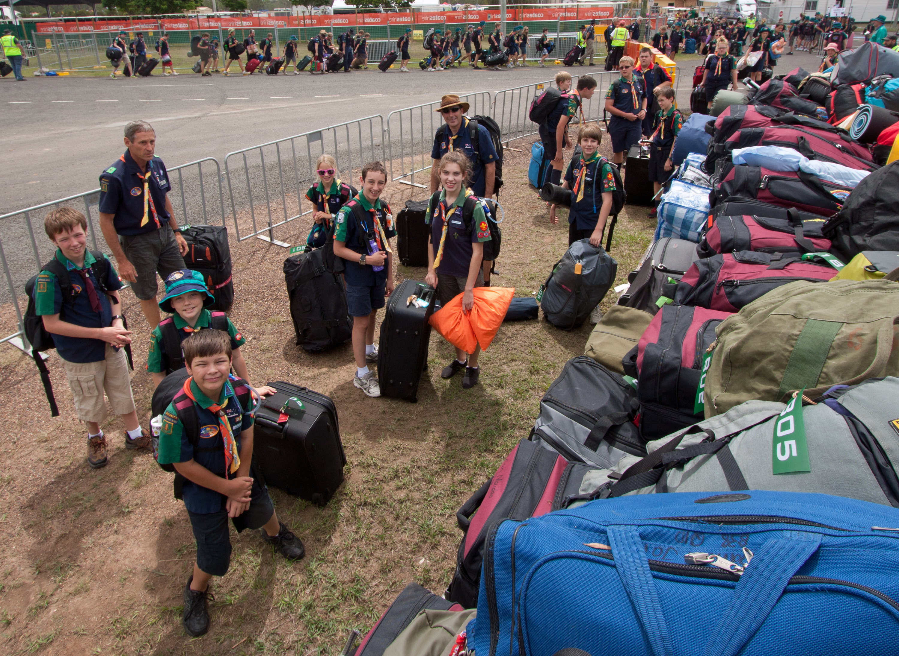
Journey to the Jamboree
Space for specific details based on your Contingent for travel plans to Maryborough, dates, times, etc.

Slide 16
What is the cost to attend the Jamboree?
PARTICIPANT (SCOUT or VENTURER) | LINE / SERVICE LEADERS (VENTURERS, ROVERS, LEADERS)
$ (fill in for your contingent) | $ (fill in for your contingent)
Includes:
Transport (to and from the Jamboree, as well as to off-site activities)
All meals for entire Jamboree
Accommodation
All activities (on-site and off-site)
Entertainment at the Jamboree
AJ & Contingent Merchandise packs
Applications close 31 March 2024

Slide 17
What to do now?
Go to the website and register to attend the Jamboree - AJ2025.com.au
Start brainstorming fundraising ideas to help pay for the Jamboree
Begin your preparation for the Jamboree. Start planning camps and identify what program achievements you need to complete before December 2024
Speak to other youth members or adults who have attended a past Australian Jamboree

Slide 18
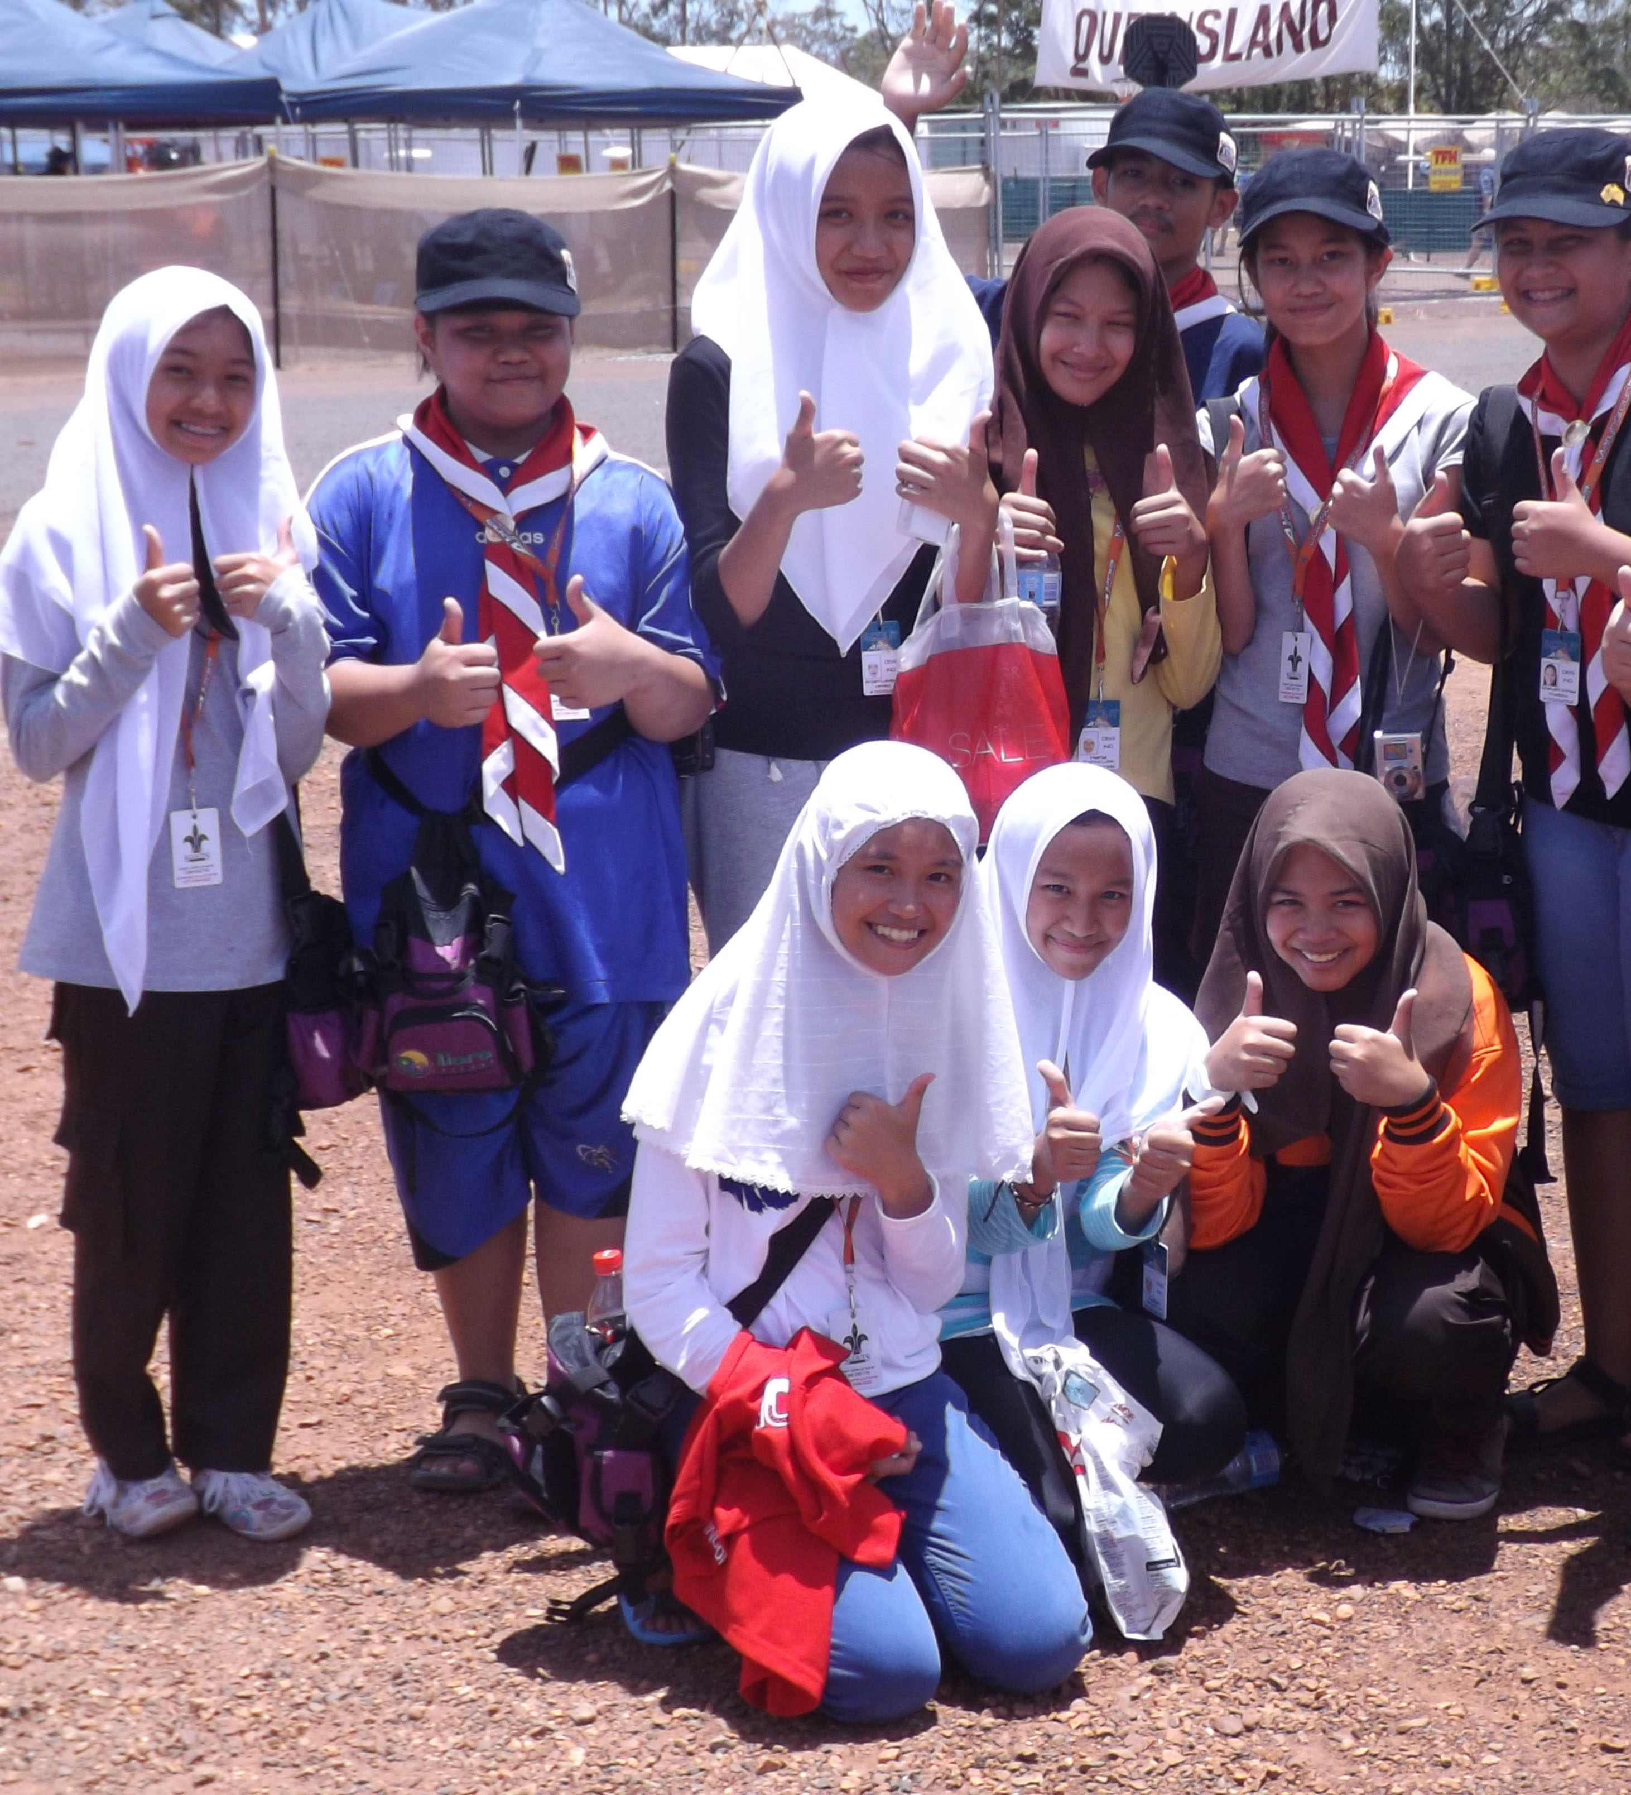
Contingent Contacts
To be filled in with your contingent contact details, website, social media (available at AJ2025.com.au)

Slide 19
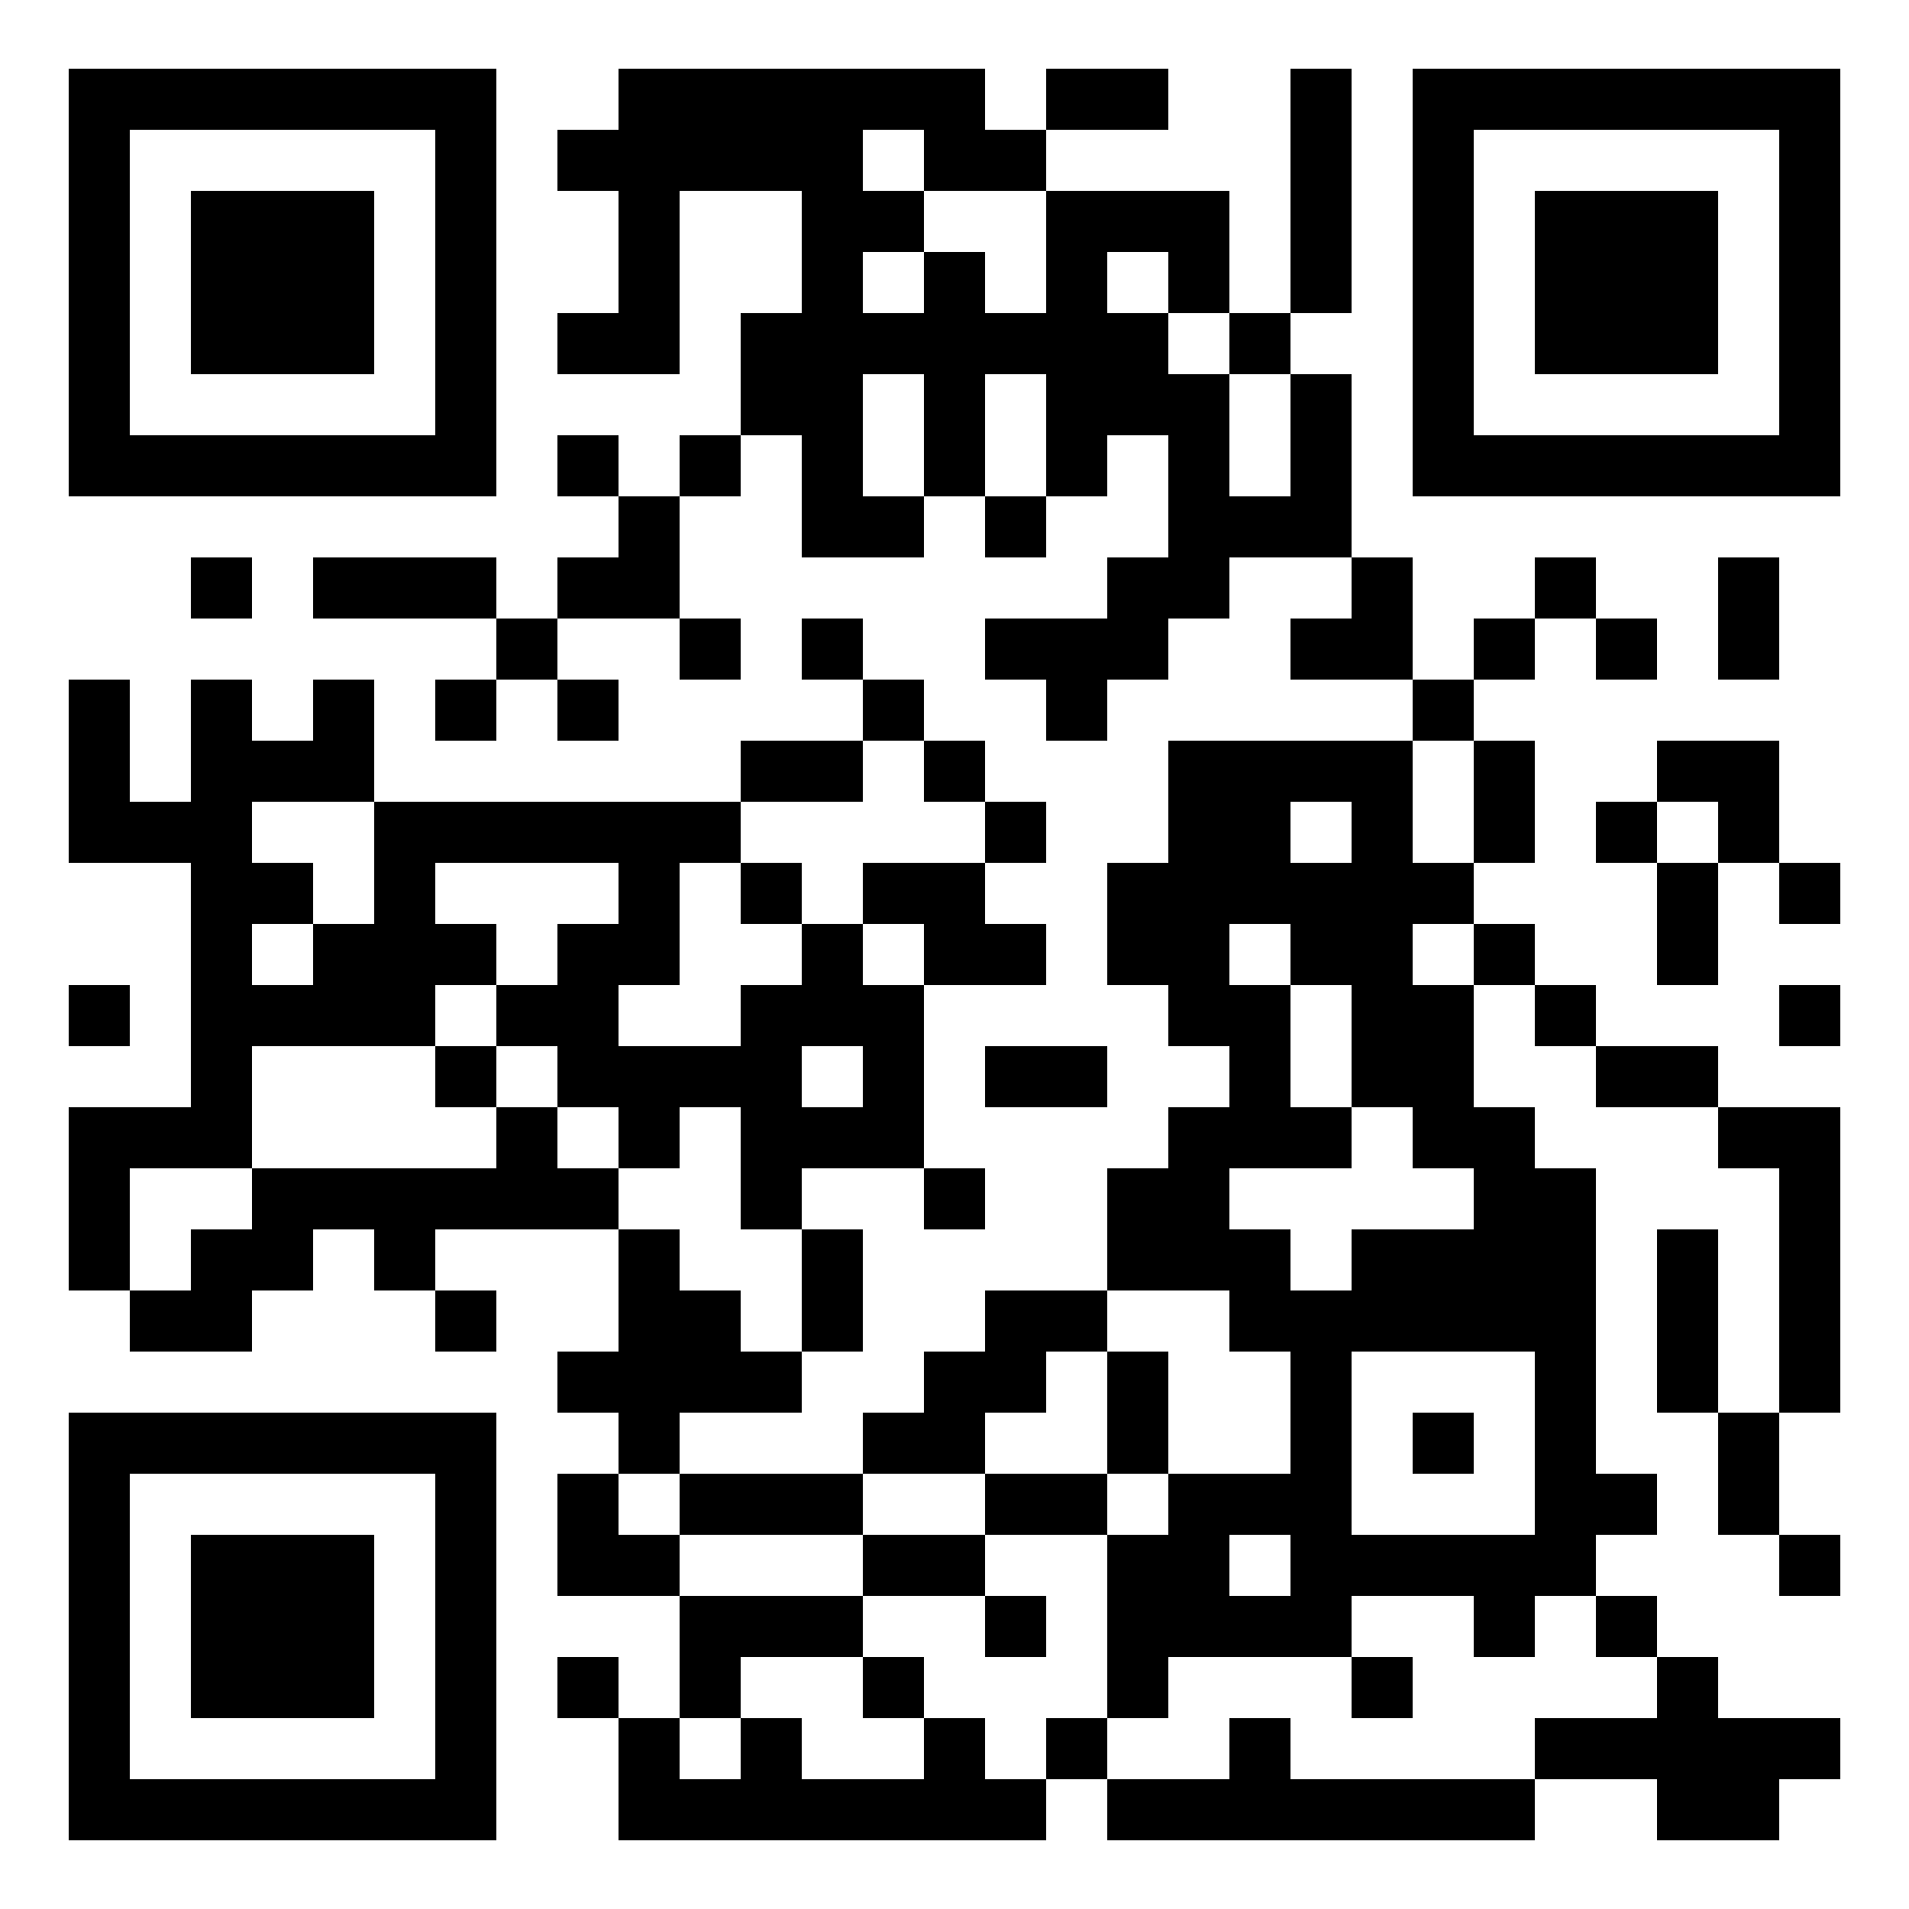
For more info
AJ2025.COM.AU Follow us on Social Media Search: AJ2025

